Slide 1
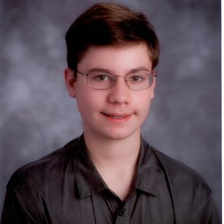
Mobile Application Development
Mamaroneck High School
Andrew Katz
10th Grade Student
Mamaroneck High School
aakatz3@gmail.com
Notes:
Hello, I’m Andrew Katz. I’m from Mamaroneck High School, and I am here to present my solution to the mobile application development competition.

Slide 2
The task was to write a mobile application announcing activities at my school including dates, times, and contact information. I was to include an events list, and a banner with images.
Notes:
Mamaroneck High School asked me to write mobile App that announces events at my school, including dates, times, and contact information. With this app, I was to package an events list and include a banner of images.

Slide 3
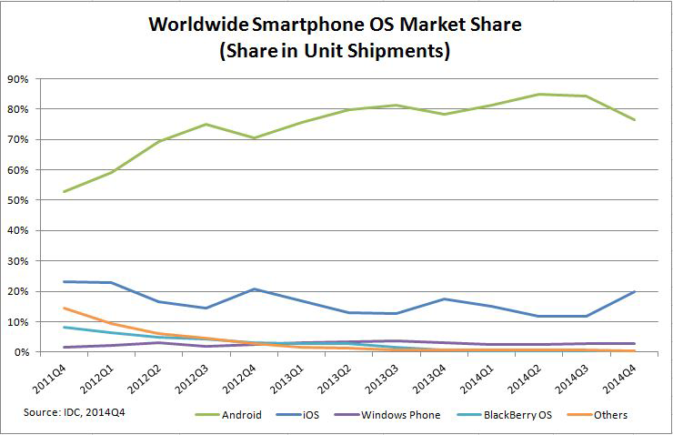
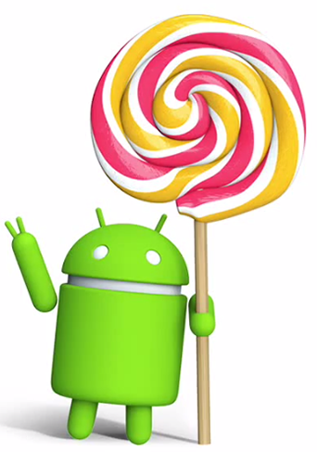
Why android?
Notes:
I chose to write my app for the android platform because, International Data Corporation’s survey found android to be the most prevalent smartphone operating system, with 76.6% of the market in the fourth quarter of 2014.

Slide 4
Design Process
Interface Design
Implement Basic Functionality
Debug
Expand Functionality
Debug
Testing
Release
Notes:
I followed a seven step design process, beginning with designing the user interface and ending with our app’s release. Throughout this process, I documented my app.

Slide 5
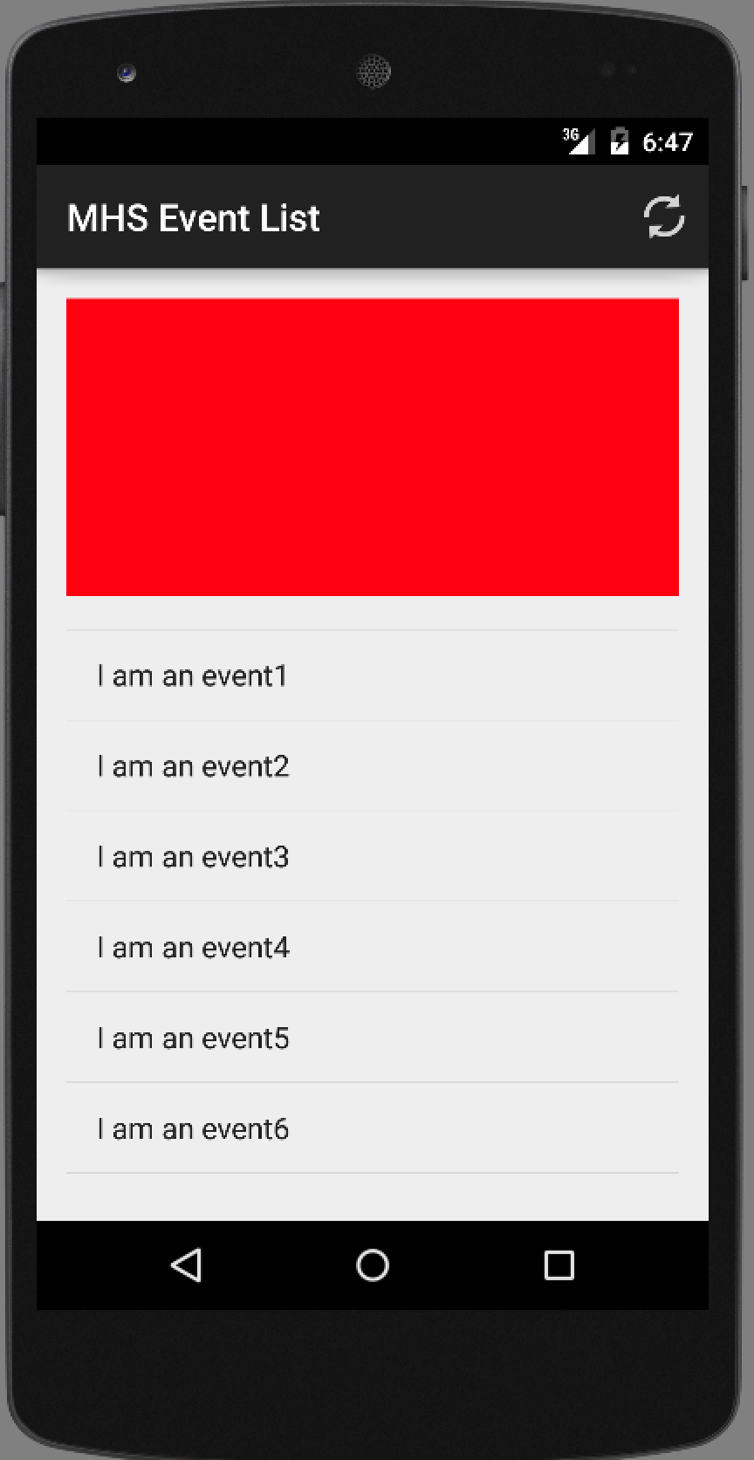
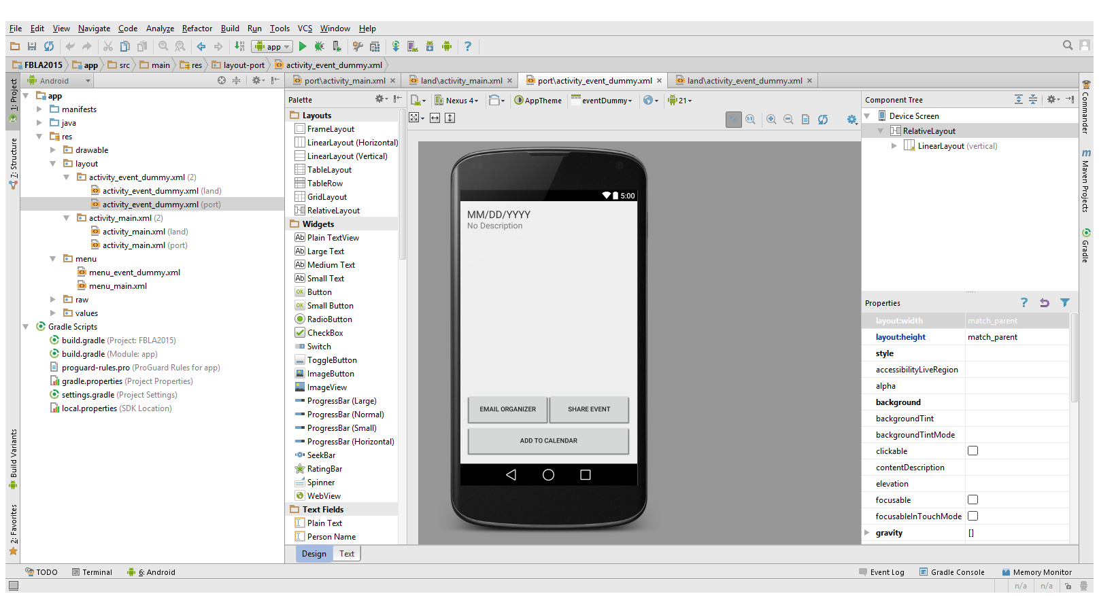
Design Process
Interface Design
Implement Basic Functionality
Debug
Expand Functionality
Debug
Testing
Release
Notes:
The first step was to design the basic user interface in Android Studio

Slide 6
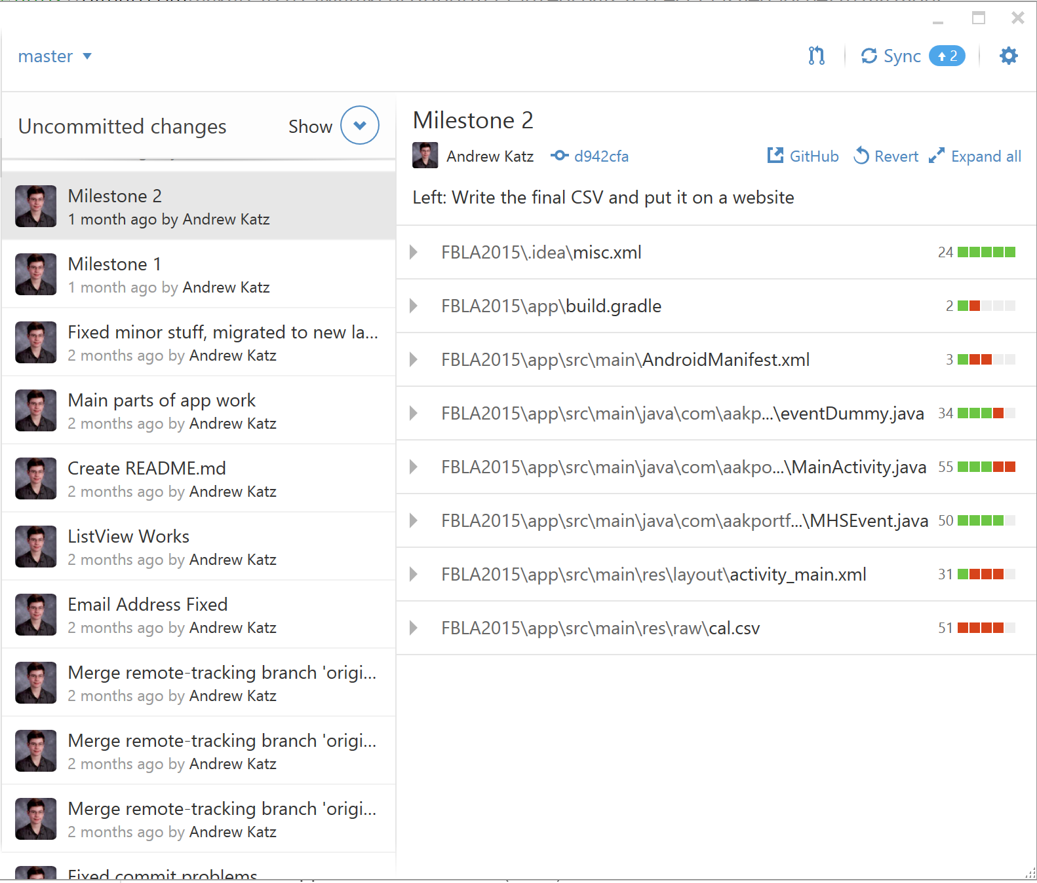
Design Process
Interface Design
Implement Basic Functionality
Debug
Expand Functionality
Debug
Testing
Release
Notes:
Next, I implemented the code behind the interface, to create a basic, functional app.

Slide 7
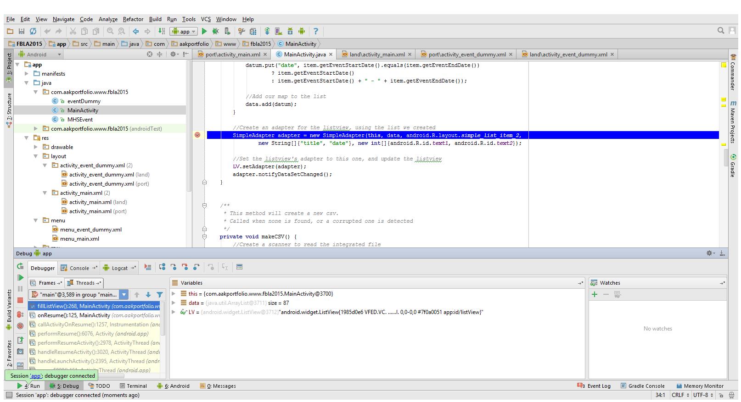
Design Process
Interface Design
Implement Basic Functionality
Debug
Expand Functionality
Debug
Testing
Release
Notes:
Then, the code was debugged for the first time.

Slide 8
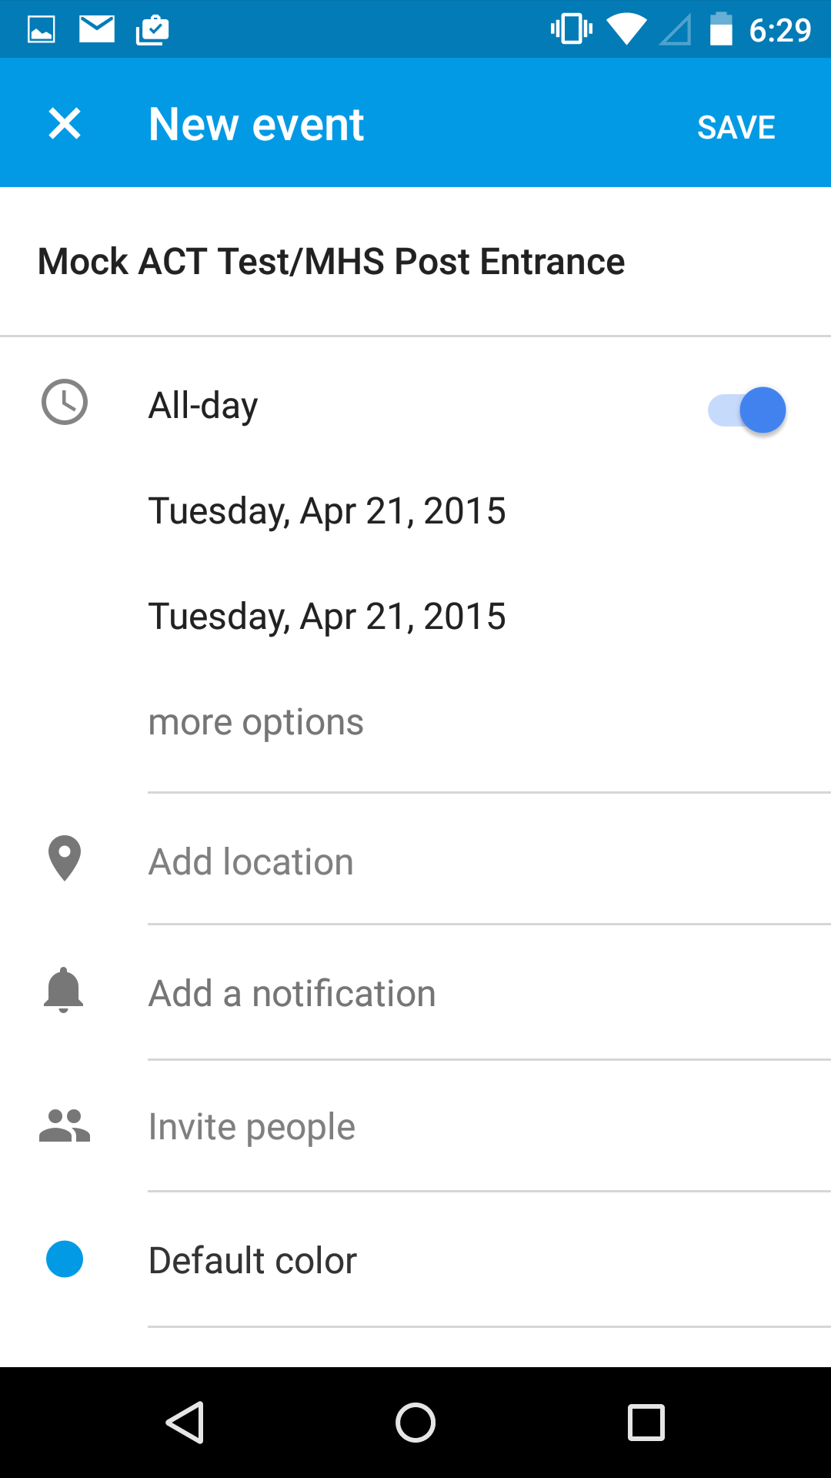
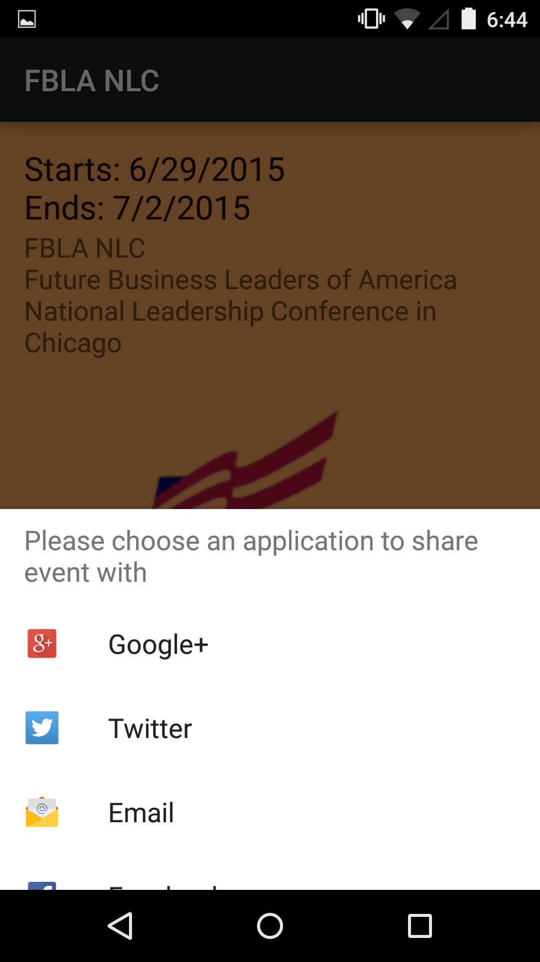
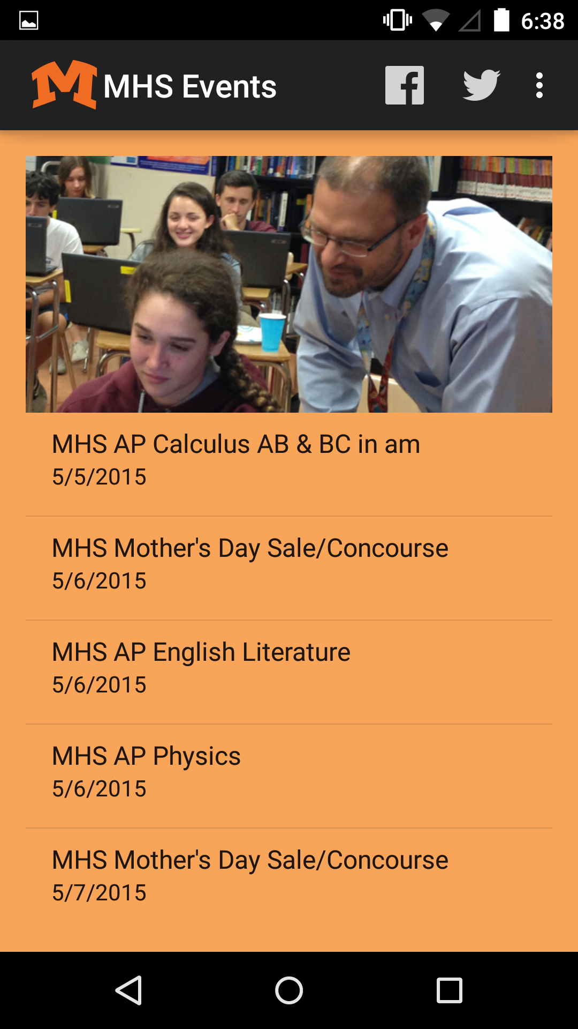
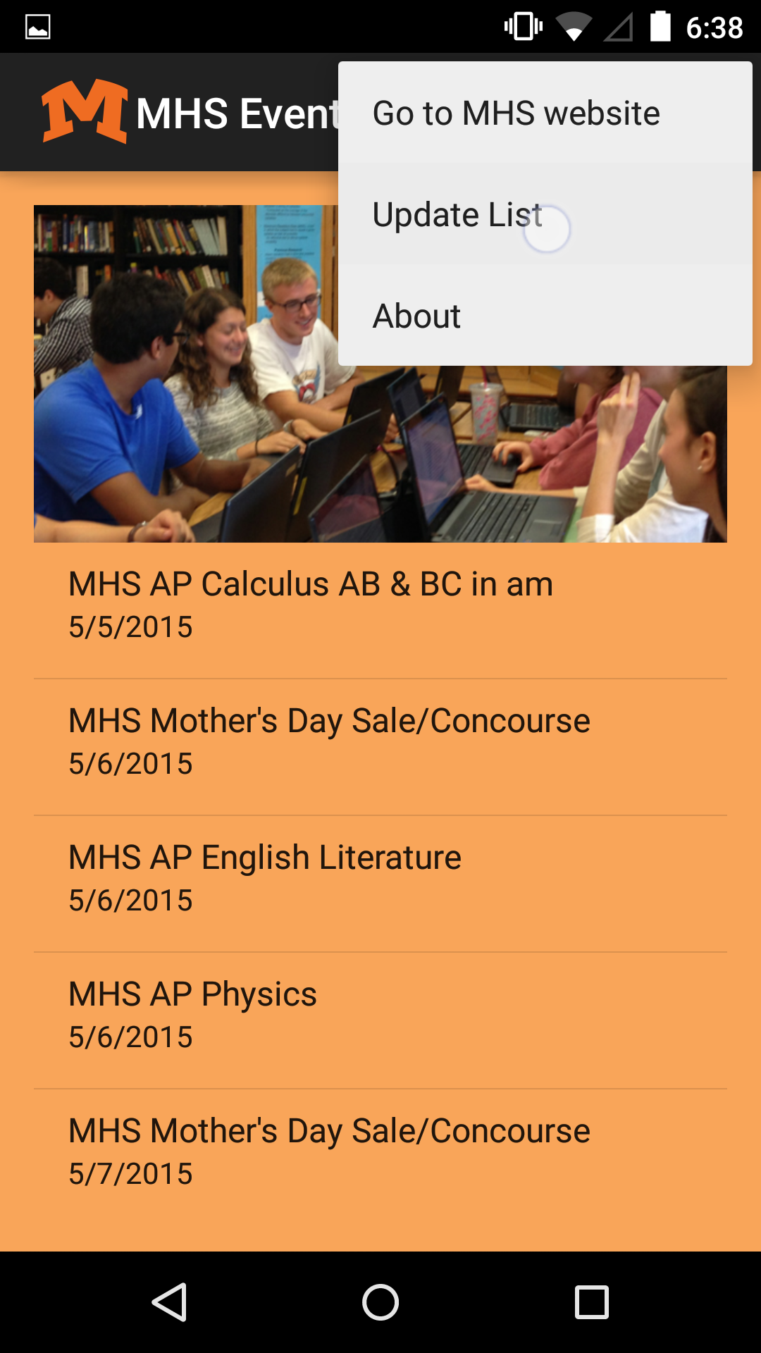
Design Process
Interface Design
Implement Basic Functionality
Debug
Expand Functionality
Debug
Testing
Release
Notes:
When the initial debugging was completed, I continued to expand the functionality of the app to go beyond the requirements, and improve the design.

Slide 9
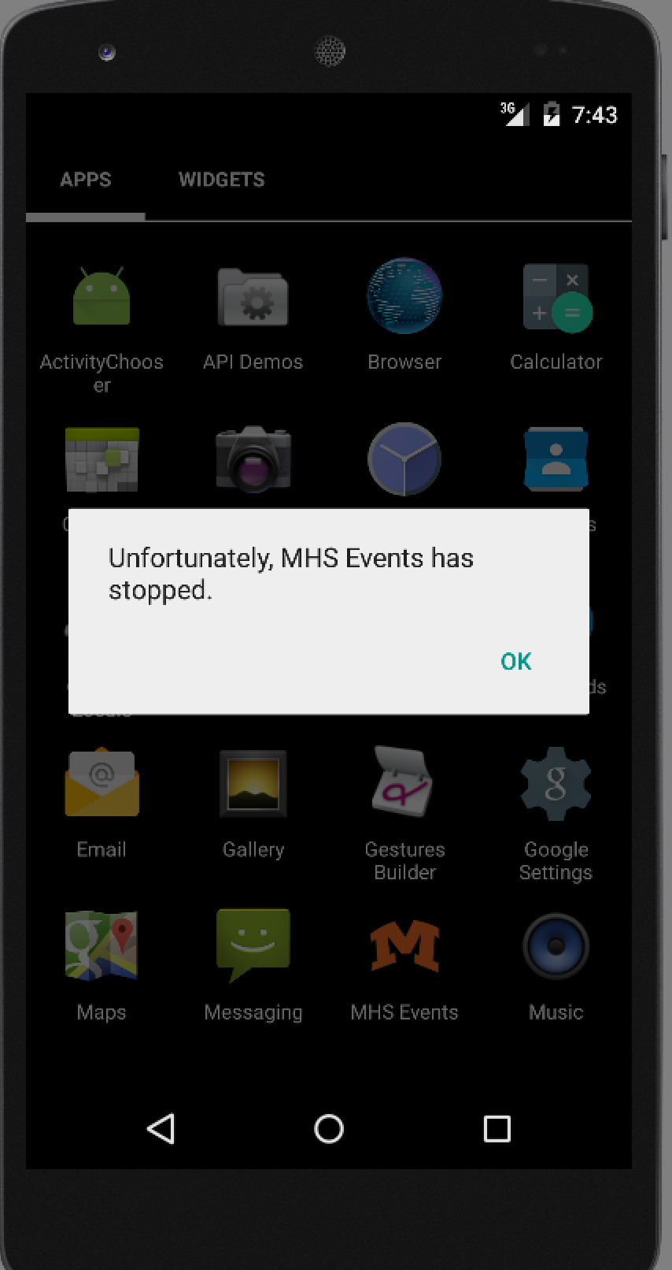
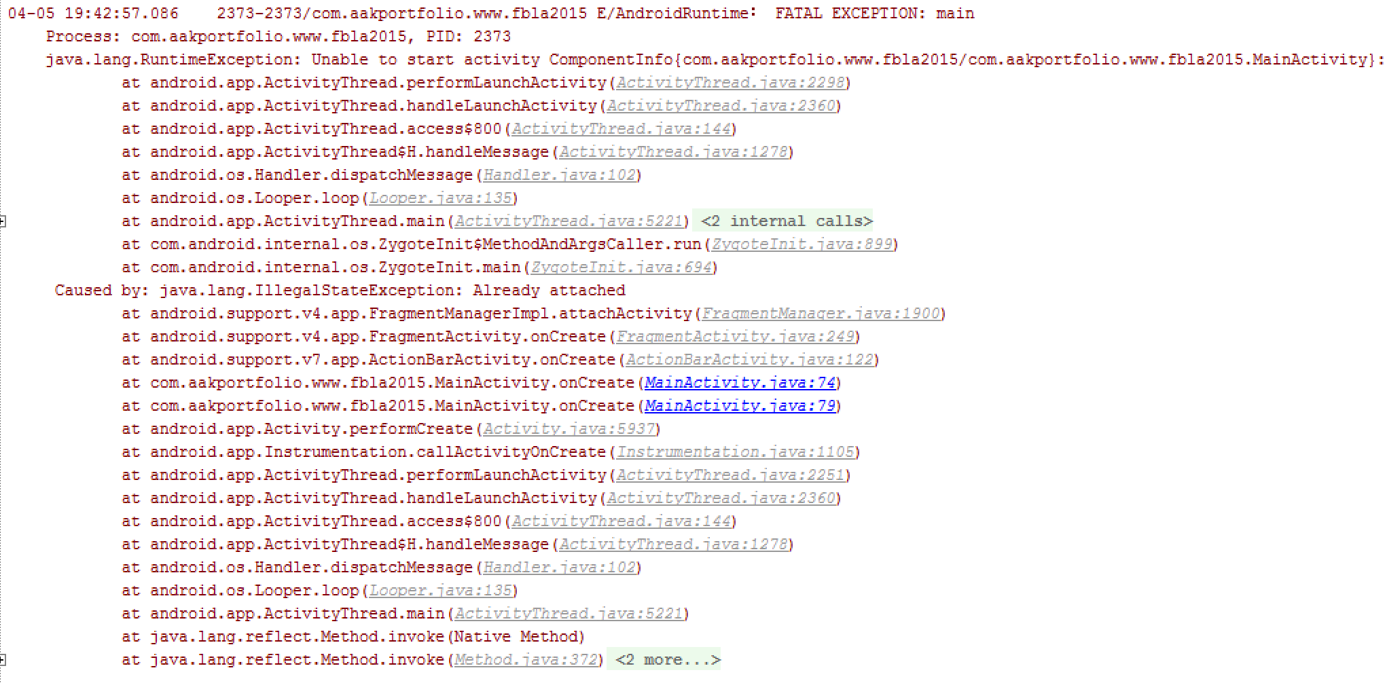
Design Process
Interface Design
Implement Basic Functionality
Debug
Expand Functionality
Debug
Testing
Release
Notes:
The app was now debugged a second time.

Slide 10
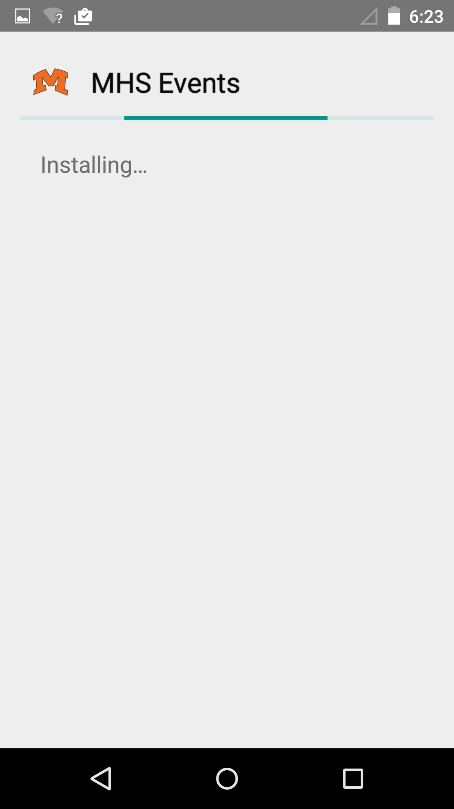
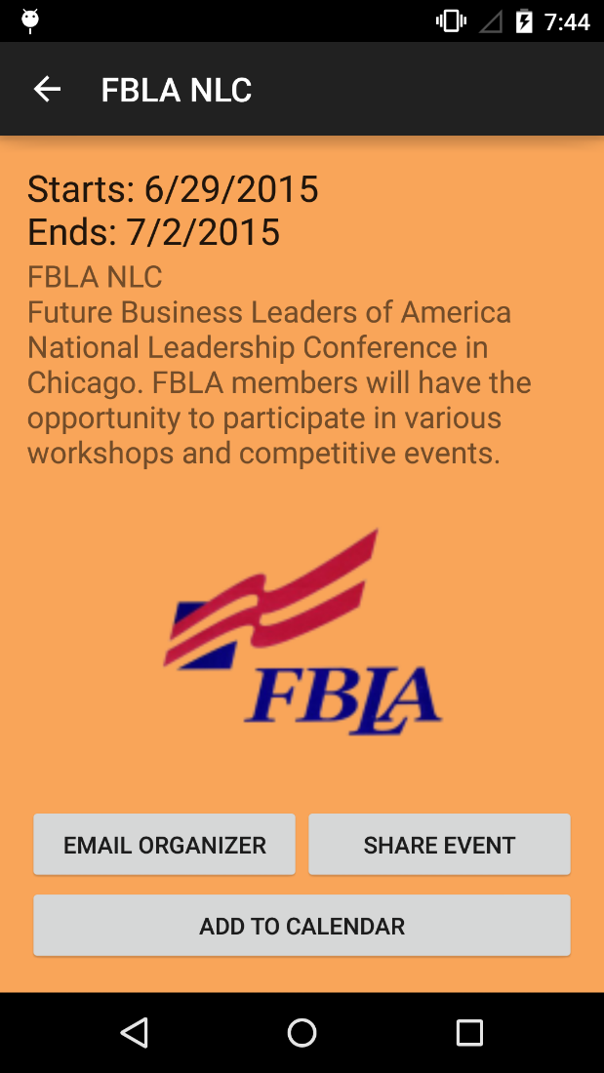
Design Process
Interface Design
Implement Basic Functionality
Debug
Expand Functionality
Debug
Testing
Release
Notes:
Lastly, the app was distributed to a limited number of users for testing, and their feedback was incorporated.

Slide 11
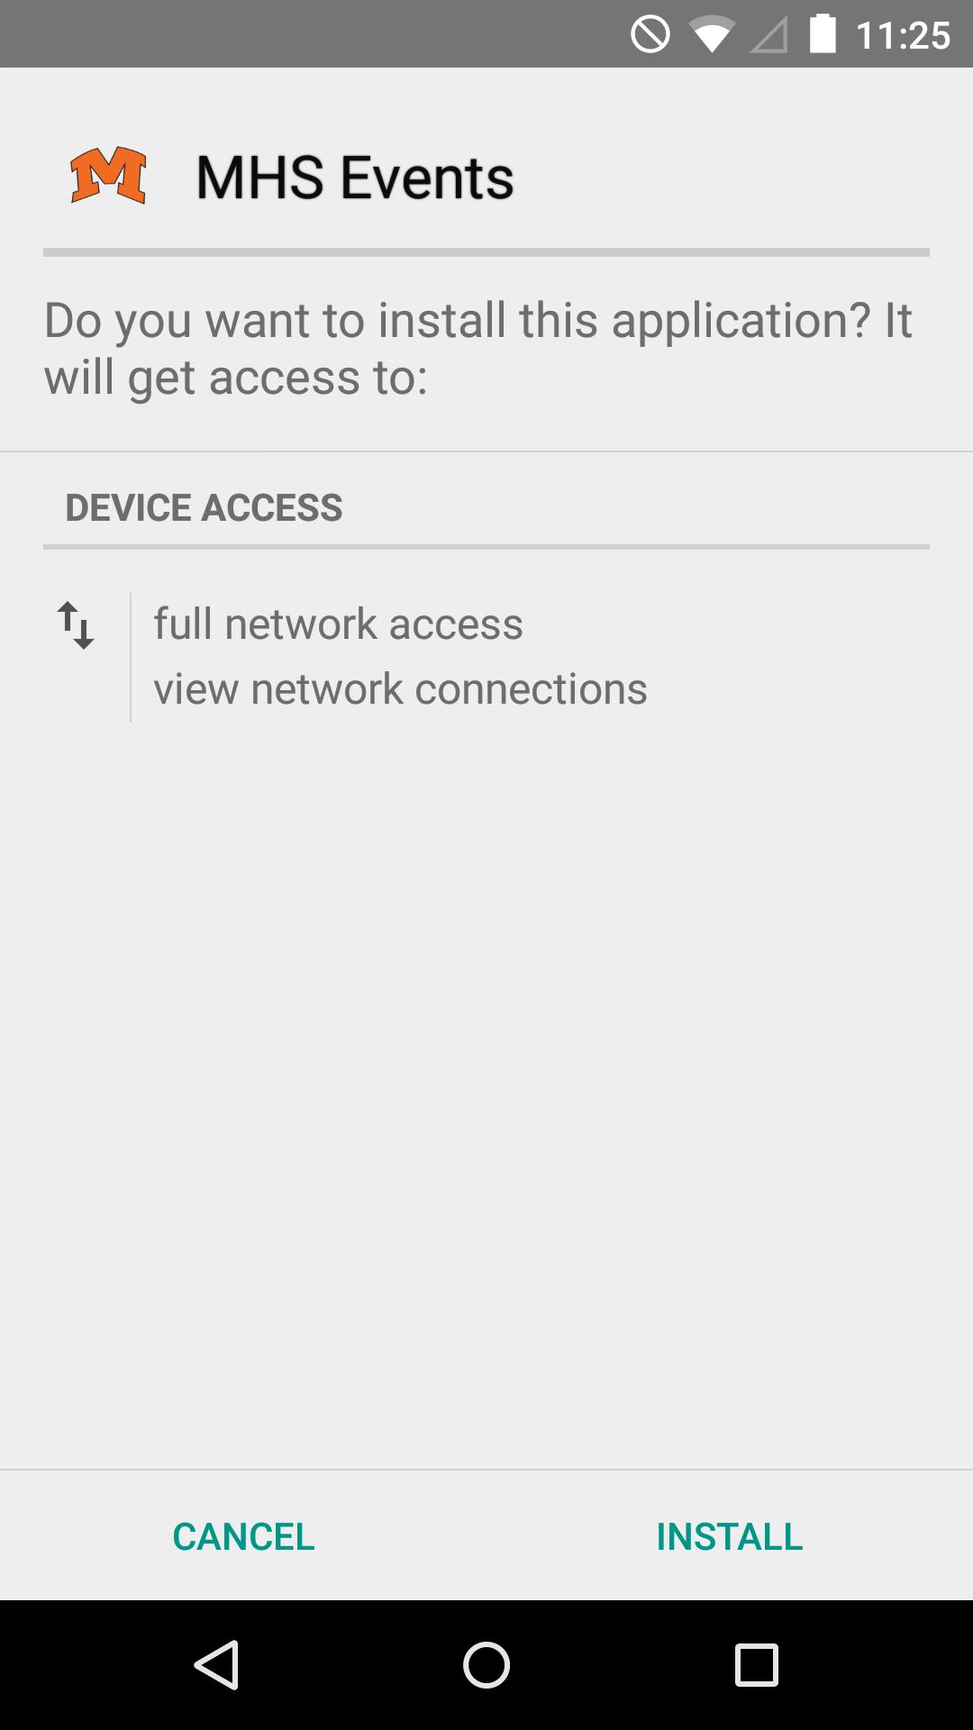
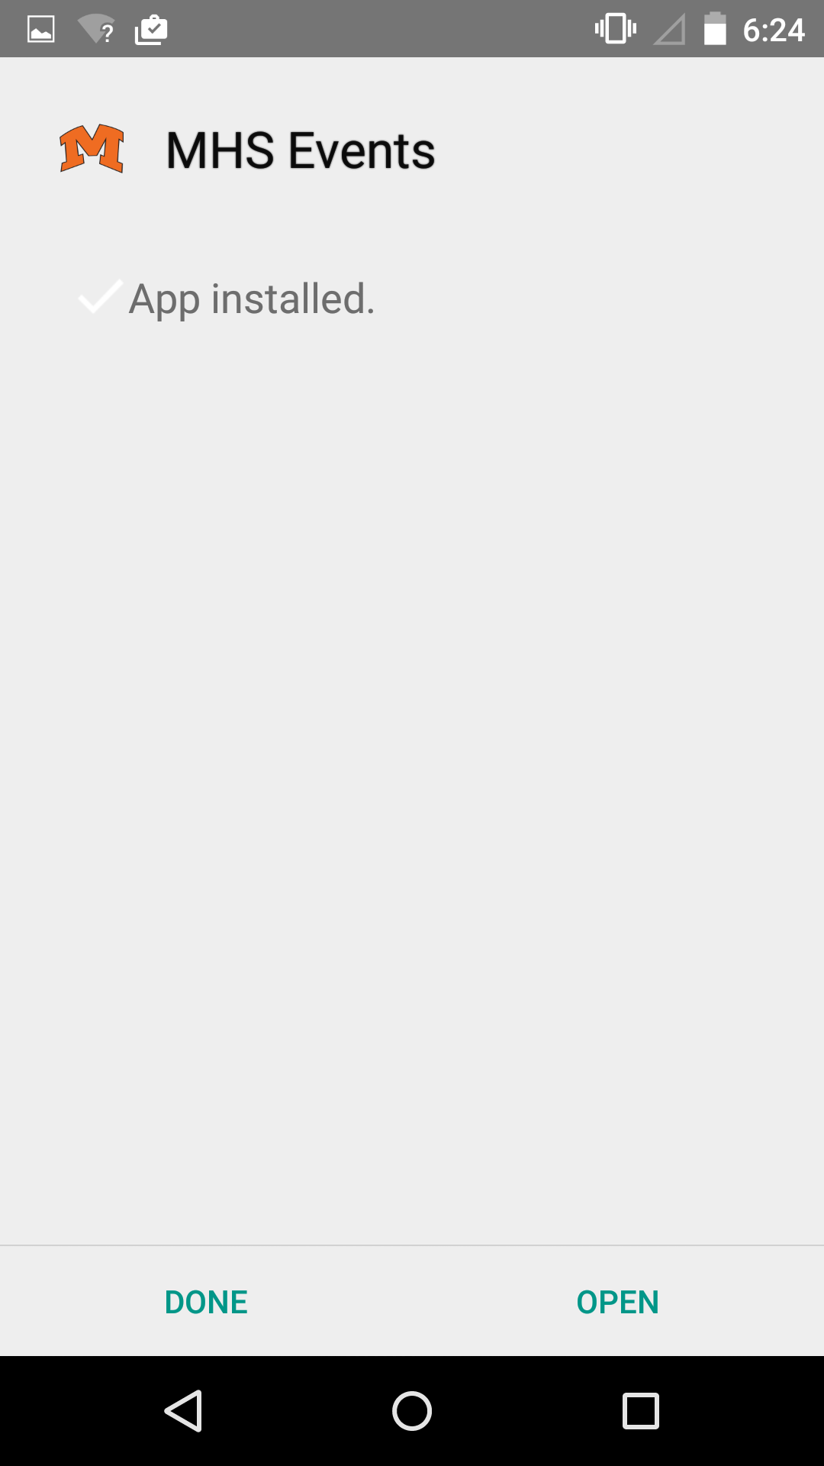
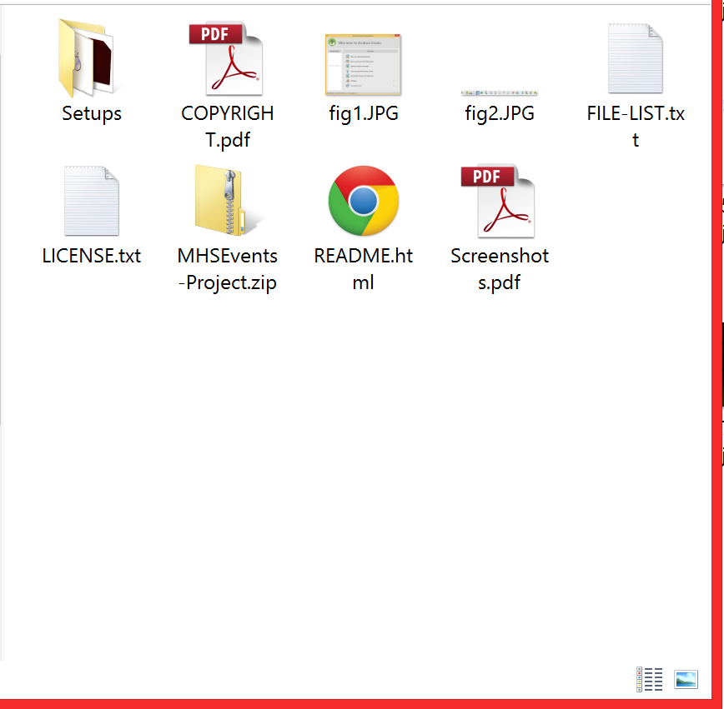
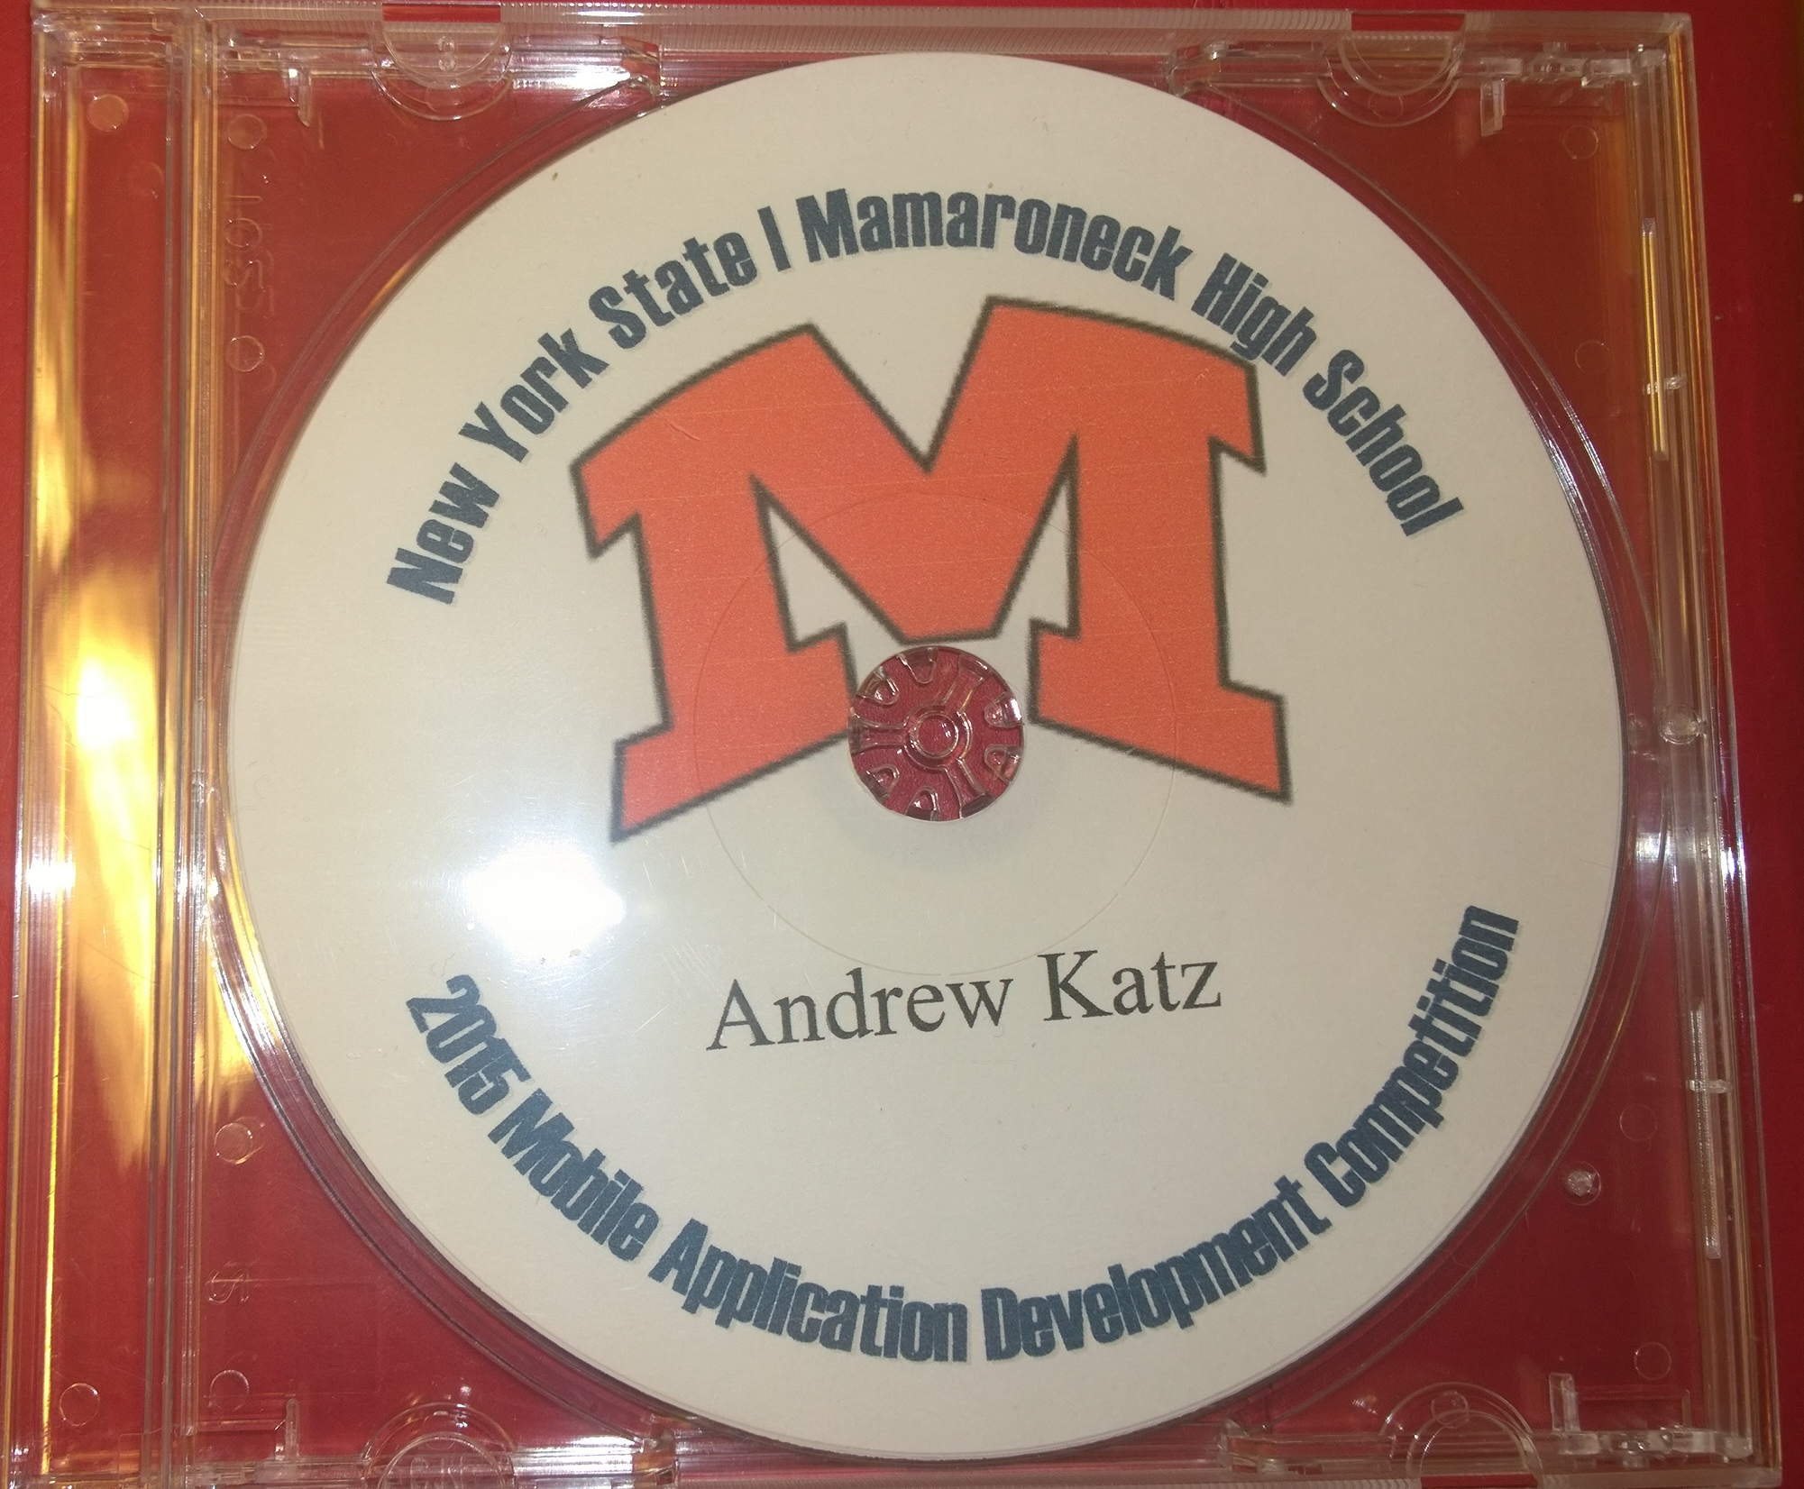
Design Process
Interface Design
Implement Basic Functionality
Debug
Expand Functionality
Debug
Testing
Release
Notes:
At this point, the app was finished, and it was packaged onto DVDs for submission and release.

Slide 12



Tools Used
Android Studio
Github
Microsoft Word
Notes:
I used three tools during the project: Android Studio for designing the app, Github for collaboration and version control, and Microsoft Word for writing the additional documentation.

Slide 13
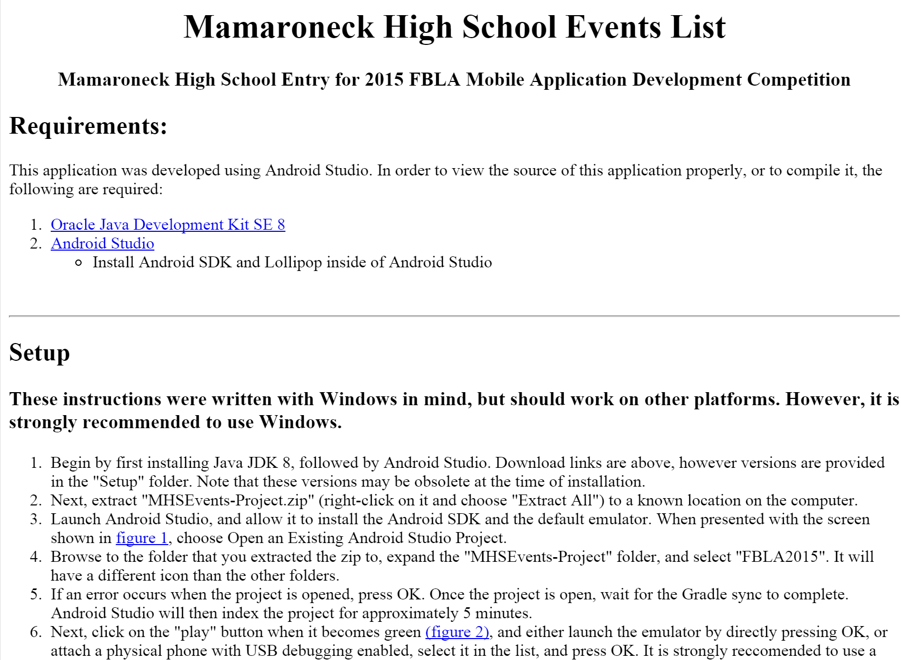
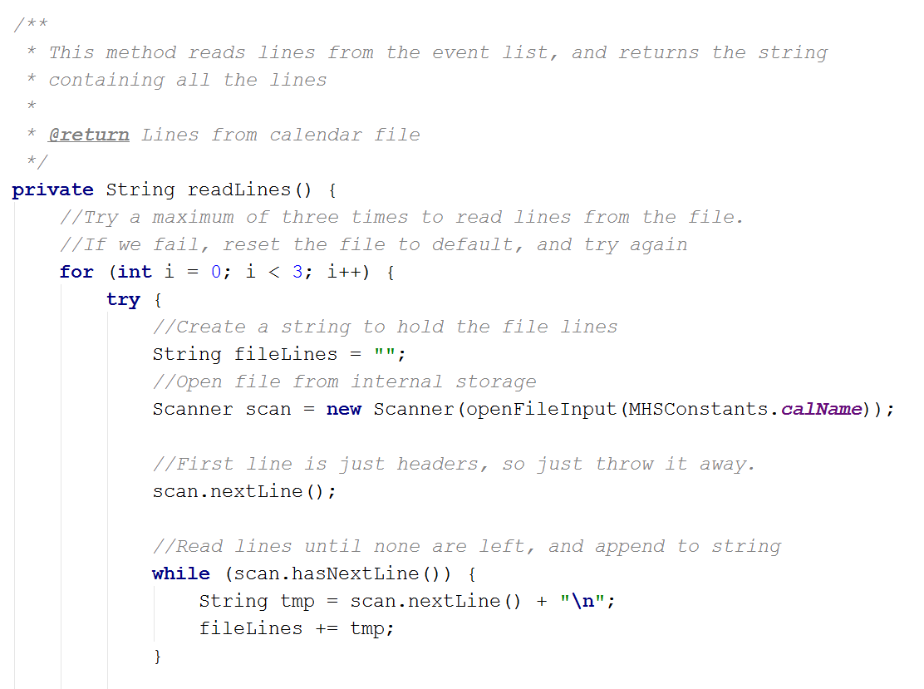
Documentation
Overall Documentation:
Readme describing procedure for testing
PDF with screenshots
In-Code Documentation:
Class-level comments
Method Comments
Notes:
I wrote two different forms of documentation: Documentation that covered the entire app, including screenshots and instructions for testing, and documentation within the code, describing classes and methods.

Slide 14
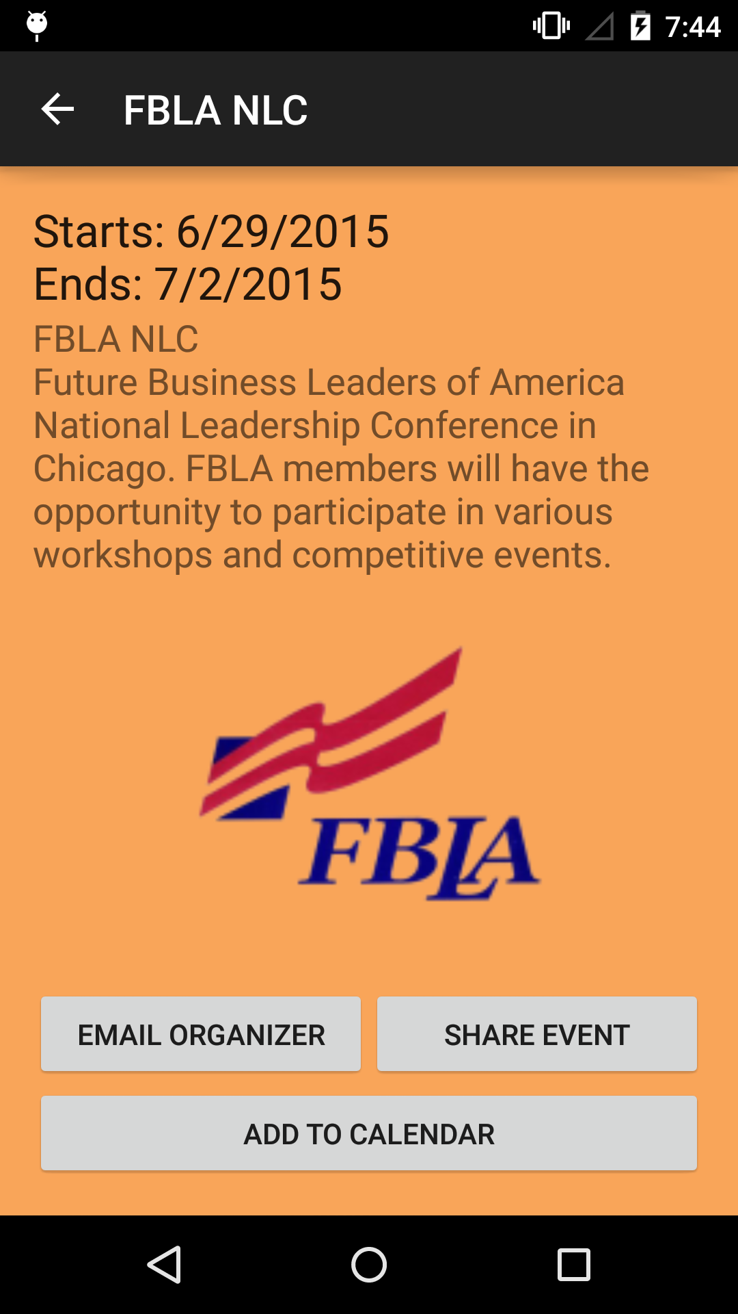
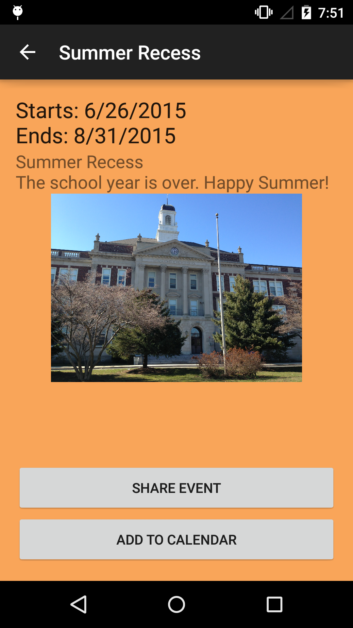
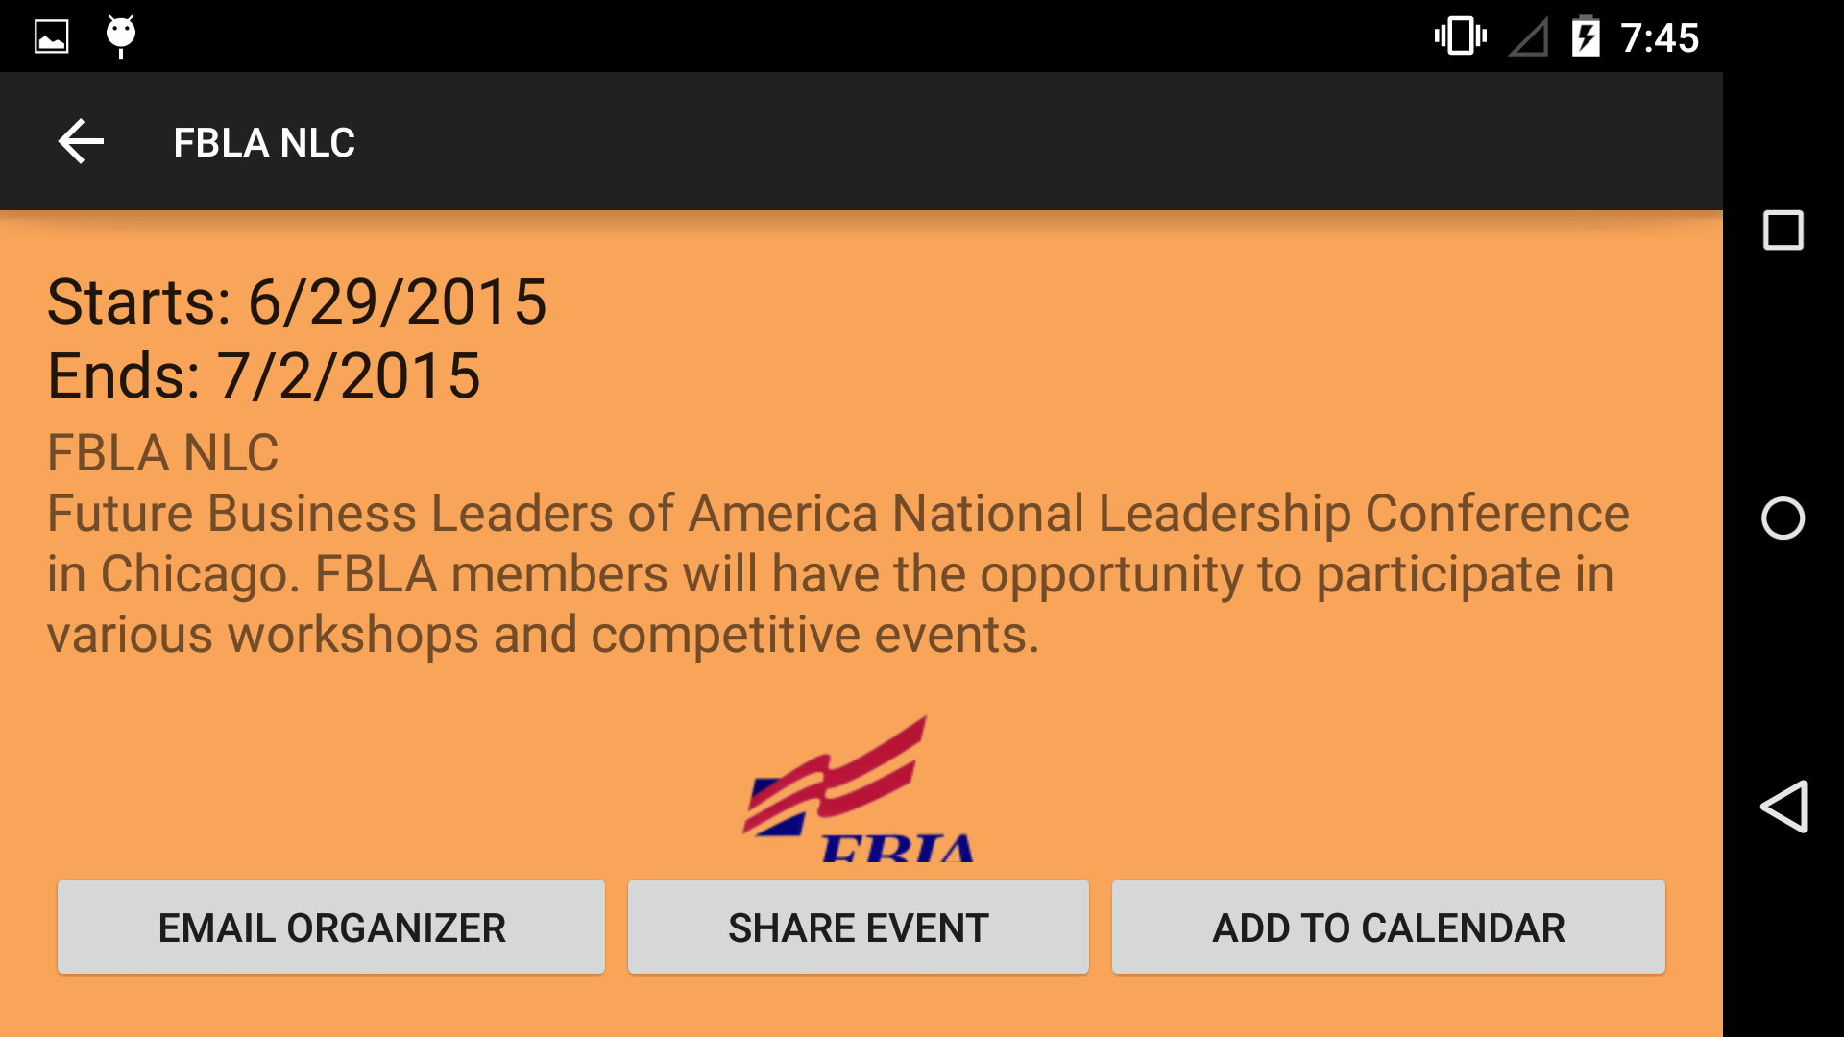
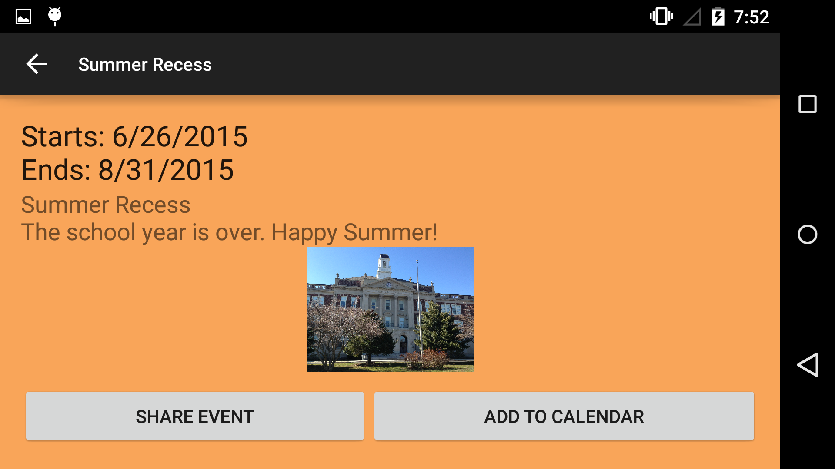
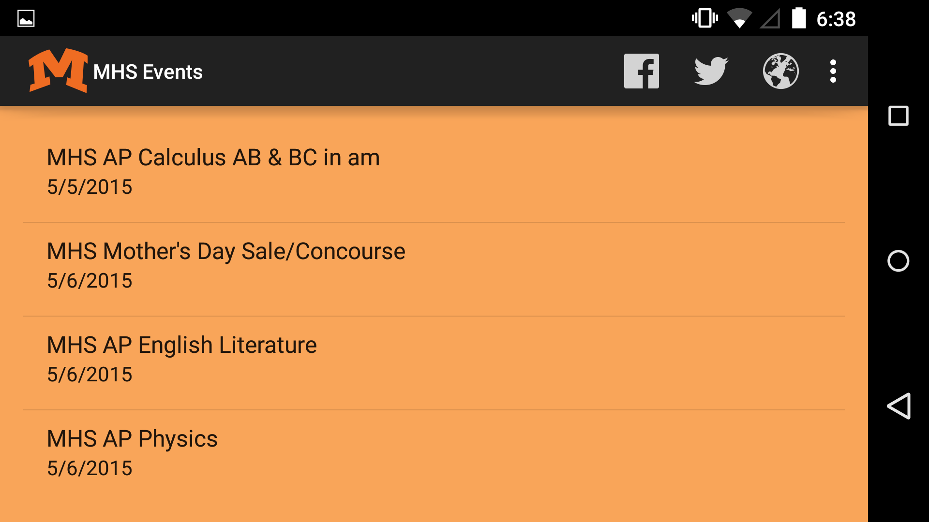

Screenshots
Notes:
This is the app’s icon. I used my school’s logo as the app icon, to make it instantly recognizable among the students.
[click]
This app’s main screen. It displays a list of events from a file included with the app. In portrait orientation, a banner of images is also displayed.
[click]
When an event is clicked on, it is displayed in a more detailed view offering actions to the user, such as sharing the event or adding to the phone’s calendar.
[click]
Most events have an organizer, and with these events, a button is displayed allowing the user to contact the organizer.

Slide 15
Live Demo
Please wait a few seconds while the demo is started…
Notes:
Please allow me a moment to switch the projector.

Slide 16
Thank you.
Are there any questions?
Notes:
Thank you very much for your time. I will now open the floor to any questions.

Slide 17
Recorded Demo

